Slide 1
IT603 – Programming
procedural programming in modern c++

Slide 2
Goals of this course
Remove fear of programming with crystal clear concepts
Deep knowledge of C++ - (non-OOP part)
Use modern C++ features in everyday programming
Use STL (Standard Template Library) in everyday programming

Slide 3
Course Evaluation Scheme
1st In-Sem Exam – 20%
2nd In-Sem Exam – 20%
End-Sem Exam – 40%
Lab work – 20% ( 10% - In lab sincerity, 10% - Assignments)

Slide 4
Course structure
PHASE I – Fundamentals (8 - 10 Lectures)
Data Types, Decisions, Operators, Arrays & Loops, Strings, Functions, Structures & Unions
PHASE II – Advanced Concepts (10-12 Lectures)
Pointer & References, Function Templates, Smart Pointers, Function Objects & Lambda Expressions
PHASE III – STL (10 -15 Lectures)
Containers, Iterators, Algorithms, Smart pointers

Slide 5
Resources & Tools
Books:
Beginning C++17 - From Novice to Professional — Fifth Edition — Ivor Horton, Peter Van Weert
Visual Studio 2022 Community Edition
https://visualstudio.microsoft.com/thank-you-downloading-visual-studio/?sku=Community&channel=Release&version=VS2022&source=VSLandingPage&passive=false&cid=2030
Any other modern C++ compiler / IDE (Like Code Blocks) is also okay

Slide 6
Basic Ideas
C++ Program Concepts
Source Files & Header Files
Comments & Whitespaces
Preprocessing Directives and Standard Library Headers
main() function
statement & statement block
data input and output – streams in c++
return statements
namespaces
creating an executable

Slide 7
Code -> Compile -> Link
stdio.lib
01010101010101
void printf(string s)
{
<output to console> s
}
file.c
#include<stdio.h>
int main()
{
printf(“hello world!”)
}
file.obj
Linker
Compile
01010101010101
Compiler
o/p
Link
stdio.h
void sprintf (string, string);
void printf(string);
:
:
File.exe

Slide 8

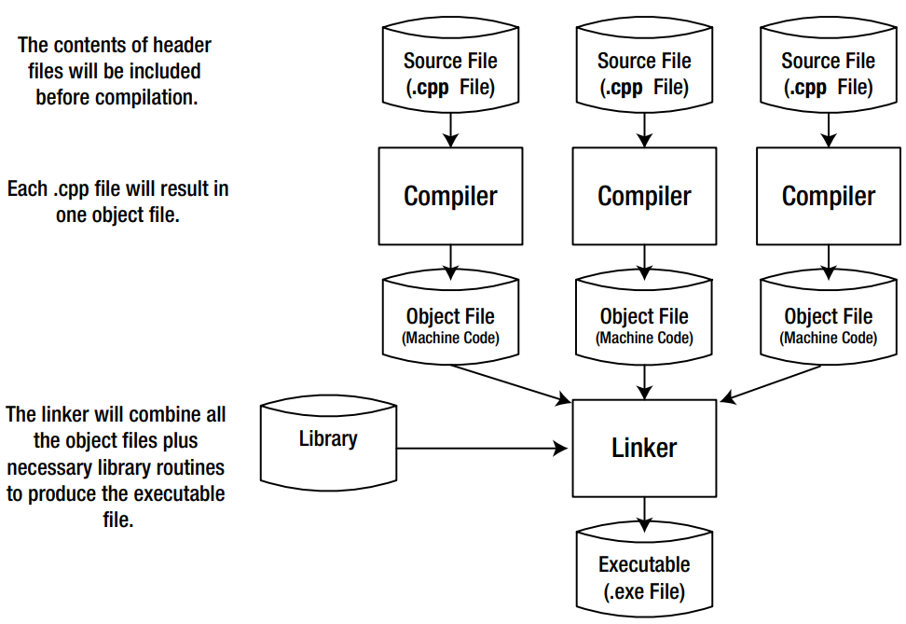

Slide 9
Representing numbers
Decimal Numbers
Binary Numbers
bit, nibble, byte
Negative binary numbers
Bi-endian and Little Endian systems
Hexadecimal Numbers
Floating point numbers
Single Precision
Double Precision

Slide 10
Representing Characters
Data inside your computer has no intrinsic meaning
Each character is assigned a unique integer value called its code or code point
ASCII Codes
65-90 for A-Z, 97-122 for a-z
lowercase letters have the sixth bit as 0, and uppercase letters have the sixth bit as 1.

Slide 11
Universal Character Set (UCS) and Unicode
UCS defines a mapping between characters and integer code values, called code points
It is important to realize that a code point is not the same as an encoding
A code point is an integer; an encoding specifies a way of representing a given code point as a series of bytes or words
Encodings are ways of representing code points that allow them to be stored more efficiently
Unicode is a standard that defines a set of characters and their code points identical to those in UCS.
Unicode Encodings – UTF8, UTF16 & UTF32
Notes:
The difference between them is in how a given character code point is presented; the numerical code value for any given character is the same in either representation. Here’s how these encodings represent characters: • UTF-8 represents a character as a variable-length sequence of between 1 and 4 bytes. The ASCII character set appears in UTF-8 as single byte codes that have the same codes values as ASCII. Most web pages use UTF-8 to encode text. • UTF-16 represents characters as one or two 16-bit values. UTF-16 includes UTF-8. Because a single 16-bit value accommodates all of code plane 0, UTF-16 covers most situations in programming for a multilingual context. • UTF-32, you guessed it, simply represents all characters as 32-bit values.

Slide 12
String Literal & Delimiters & Escape Sequences
std::cout << "\"Least \'said\' \\\n\t\tsoonest \'mended\'.\""<< std::endl;
everything between the outer double quotes in the preceding statement gets sent to cout
A string of characters between a pair of double quotes is called a string literal
The double quote characters are delimiters that identify the beginning and end of the string literal; they aren’t part of the string.
Notes:
Each escape sequence in the string literal will be converted to the character it represents by the compiler, so the
character will be sent to cout, not the escape sequence itself. A backslash in a string literal always indicates
the start of an escape sequence, so the first character that’s sent to cout is a double quote character.

Slide 13
Variables, Data, and Data Types
A variable has – a name, a data type and occupies (stack) memory
Defining integer variables:
int apple_count;
int apple_count {15}; // braced or uniform initialization (starting C++ 11)
braced initializer form is slightly safer :
int banana_count(7.5); // May compile without warning
int coconut_count = 5.3; // May compile without warning
int papaya_count{0.3}; // At least a compiler warning, often an error

Slide 14
A day in Variable’s life
Stack Memory of Process
{
int i;
i = 58;
int j = 30;
int k = i + j;
}
:
:
0x239AB78
i
0x292E3FA
302829902
:
:
58
0x402ACE3
k
0x402ADF6
0x402E3FA
88
0x403ACE3
0x502ACEE
:
:
j
0x402ACE3
30
0x502A559
0x639AFC9
:
:

Slide 15
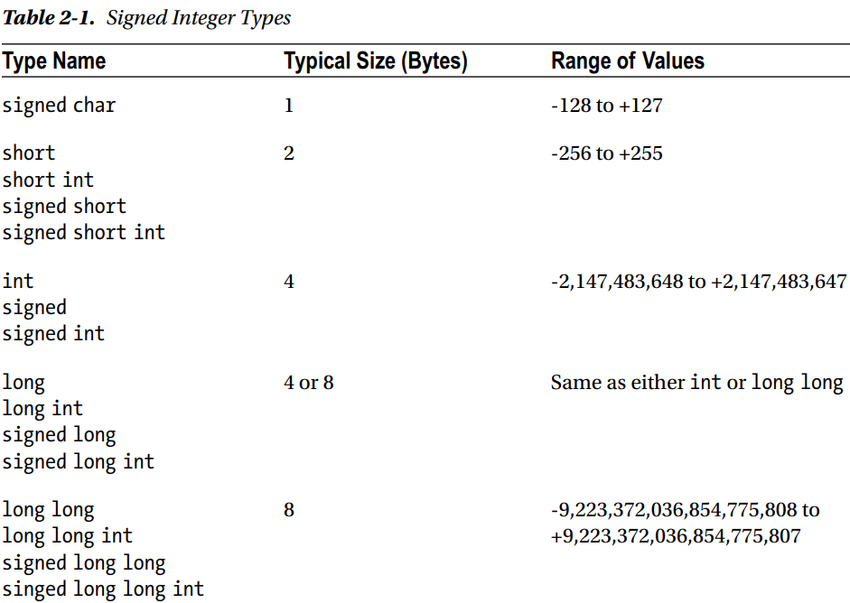
Notes:
why should you worry about bytes saved? Think mobile dev.

Slide 16
Unsigned Integer type
Integer literals
-123L
+123
123
22333
98U
-1234LL
12345ULL
useful when used with auto keyword
you can use the single quote character, ', to make numeric literals more readable (C++14). Here’s an example:
22'333
-1'234LL
12'345ULL

Slide 17
Hexadecimal Literals
e.g.: 0x1AF2B
Binary Literals (C++ 14)
e.g. 0B1010 or 0b1010

Slide 18
Calculations with Integers
Unary & Binary operators
Basic Arithmetic Operations: + - * / %
Integer division
Compound Operations - *,/ and % before + and -
Assignment Operation – to overwrite the existing value of a variable
const keyword is used for variables whose value should not change
op= Assignment operator
using namespace std;
sizeof operator
++ --

Slide 19
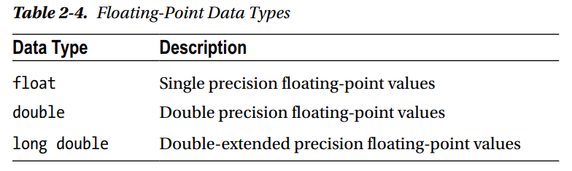
Defining Floating point variables
You cannot use the unsigned or signed modifiers with floating-point types; floating-point types are always signed

Slide 20
Floating-Point Literals
float literals have f (or F) appended and long double literals have L (or l) appended
Floating-point literals without a suffix are of type double
5E3 (5000.0) 100.5E2 (10050.0) 2.5e-3 (0.0025) -0.1E-3L (-0.0001L) .345e1F (3.45F)
Invalid Floating-Point Results : +infinity, -infinity, NaN
cmath header – pow, sqrt, round
Notes:
double a{ 1.5 }, b{}, c{}; double result { a / b }; std::cout << a << "/" << b << " = " << result << std::endl; std::cout << result << " + " << a << " = " << result + a << std::endl; result = b / c; std::cout << b << "/" << c << " = " << result << std::endl;
to check whether a given number is either infinity or nan, you should use the std::isinf() and std::isnan() functions provided by the cmath heade

Slide 21

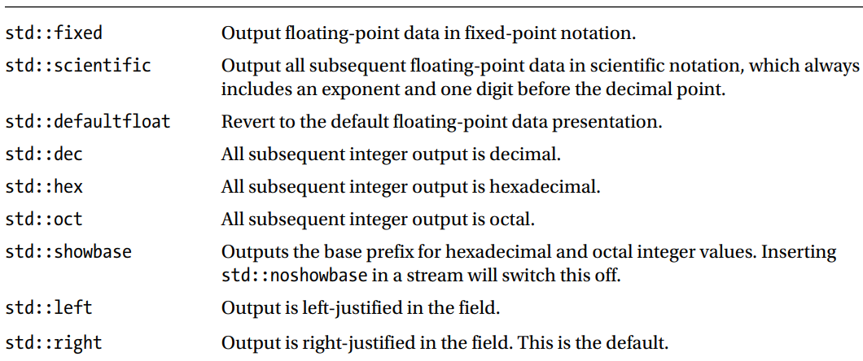
Formatting Stream Output
You can change how data is formatted when it is written to an output stream using stream manipulators
declared in the iomanip and ios Standard Library headers

Slide 22
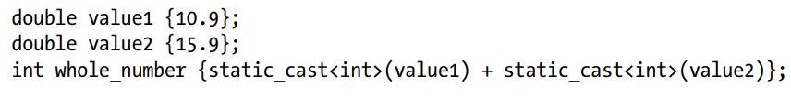
Explicit Type Conversion
static_cast<type_to_convert_to>(expression)
The static_cast keyword reflects the fact that the cast is checked statically, that is, when the code is compiled.
old style casts

Slide 23

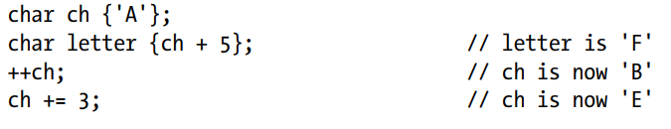
Working with character variables
Participation in arithmetic expressions

Slide 24
Working with Unicode Characters
wchar_t
wchar_t wch {L’Z’};
wchar_t wch{L’\x0438’}
char16_t
char16_t letter {u ‘B’}
char16_t cyr {u’\x0438’}
char32_t
char32_t cyr {U’\x0438’}
std::wcout and std::wcin

Slide 25
Working with fundamental types
Operator Precedence and Associativity
same precedence (or priority order) : +,-
a + b – c + d
Left and right associated operators
Right – unary, assignment and conditional (?:)

Slide 26
bitwise operators
Left and Right Shift Operators
Logical Operations on Bit Patterns
~ - Bitwise Compliment Operator – Inverts bits
& - Bitwise AND operator – ANDs bits – 1 & 1 = 1, rest 0
| - Bitwise OR operator – ORs bits – 0 | 0 = 0, rest 1
^ - Bitwise XOR operator – XORs bits – 1 ^ 0, 0 ^ 1 = 1 else 0

Slide 27
Arrays
Variables store single data item / value. Arrays store multiple values of same data type
double temperatures[366];
compile time constant for declaring the size of the array
allocated contiguous block of memory on stack
0 based index
temperatures[36] = 43.5;
unsigned int height[6] {26, 37, 47}; // Element values: 26 37 47 0 0 0 unsigned int height[6] {}; // All elements 0 const unsigned int height[6] {26, 37, 47, 55, 62, 75};

Slide 28
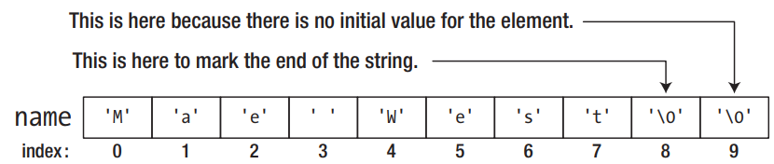
Array of characters
const char vowels[5] {'a', 'e', 'i', 'o', 'u’};
char vowels[6] {'a', 'e', 'i', 'o', 'u'}; The last element will be initialized with '\0’
char name[10] {"Mae West"};
std::cout << name << std::endl; will print all characters due to null terminated array

Slide 29
Range Based For loop
The range-based for loop iterates over all the values in a range of values.
What is a range?
An array is a range of elements
A string is a range of characters
Containers provided by STL are all ranges
for (range_declaration : range_expression) loop statement or block;
Note that the values from the range are assigned to the range variable, x. This means you cannot modify the elements of values by modifying the value of x.
Notes:
int values [] {2, 3, 5, 7, 11, 13, 17, 19, 23, 29}; int total {}; for (int x : values) total += x;

Slide 30
multi-dimensional arrays
Arrays with more than one index
double carrots[3][4] {};
Still contiguous blocks of memory – not like a table!

